Slide 1
SAMSUNG INNOVATION CAMPUS Project : AI-Enabled Crop Disease Detection via Smartphone Images Subtitle: Leveraging Deep Learning and Explainable AI for Precision Agriculture
Presented by:
NAME : JYOTI JADHAV
USN : 2KE23CS405
DEPT : CSE
DOMAIN : AIML

Slide 2
PROBLEM STATEMENT
Manual plant disease detection is slow and often inaccurate, especially where expert access is limited.An AI-based system can automatically identify diseases from leaf images and provide timely solutions to improve crop yield.

Slide 3
To develop a deep learning model for plant disease classification
To automate disease detection using leaf images
To provide instant prediction results with remedies
To build a user-friendly web interface for farmers
OBJECTIVES

Slide 4
INTRODUCTION
Agriculture plays a vital role in the global economy
Crop diseases pose a significant threat to food production
Traditional disease identification relies on manual inspection
Manual methods are time-consuming and require expert knowledge
Artificial Intelligence and Deep Learning enable automated detection
This project uses a CNN model to detect diseases from leaf images
The system provides faster and more accurate diagnosis

Slide 5
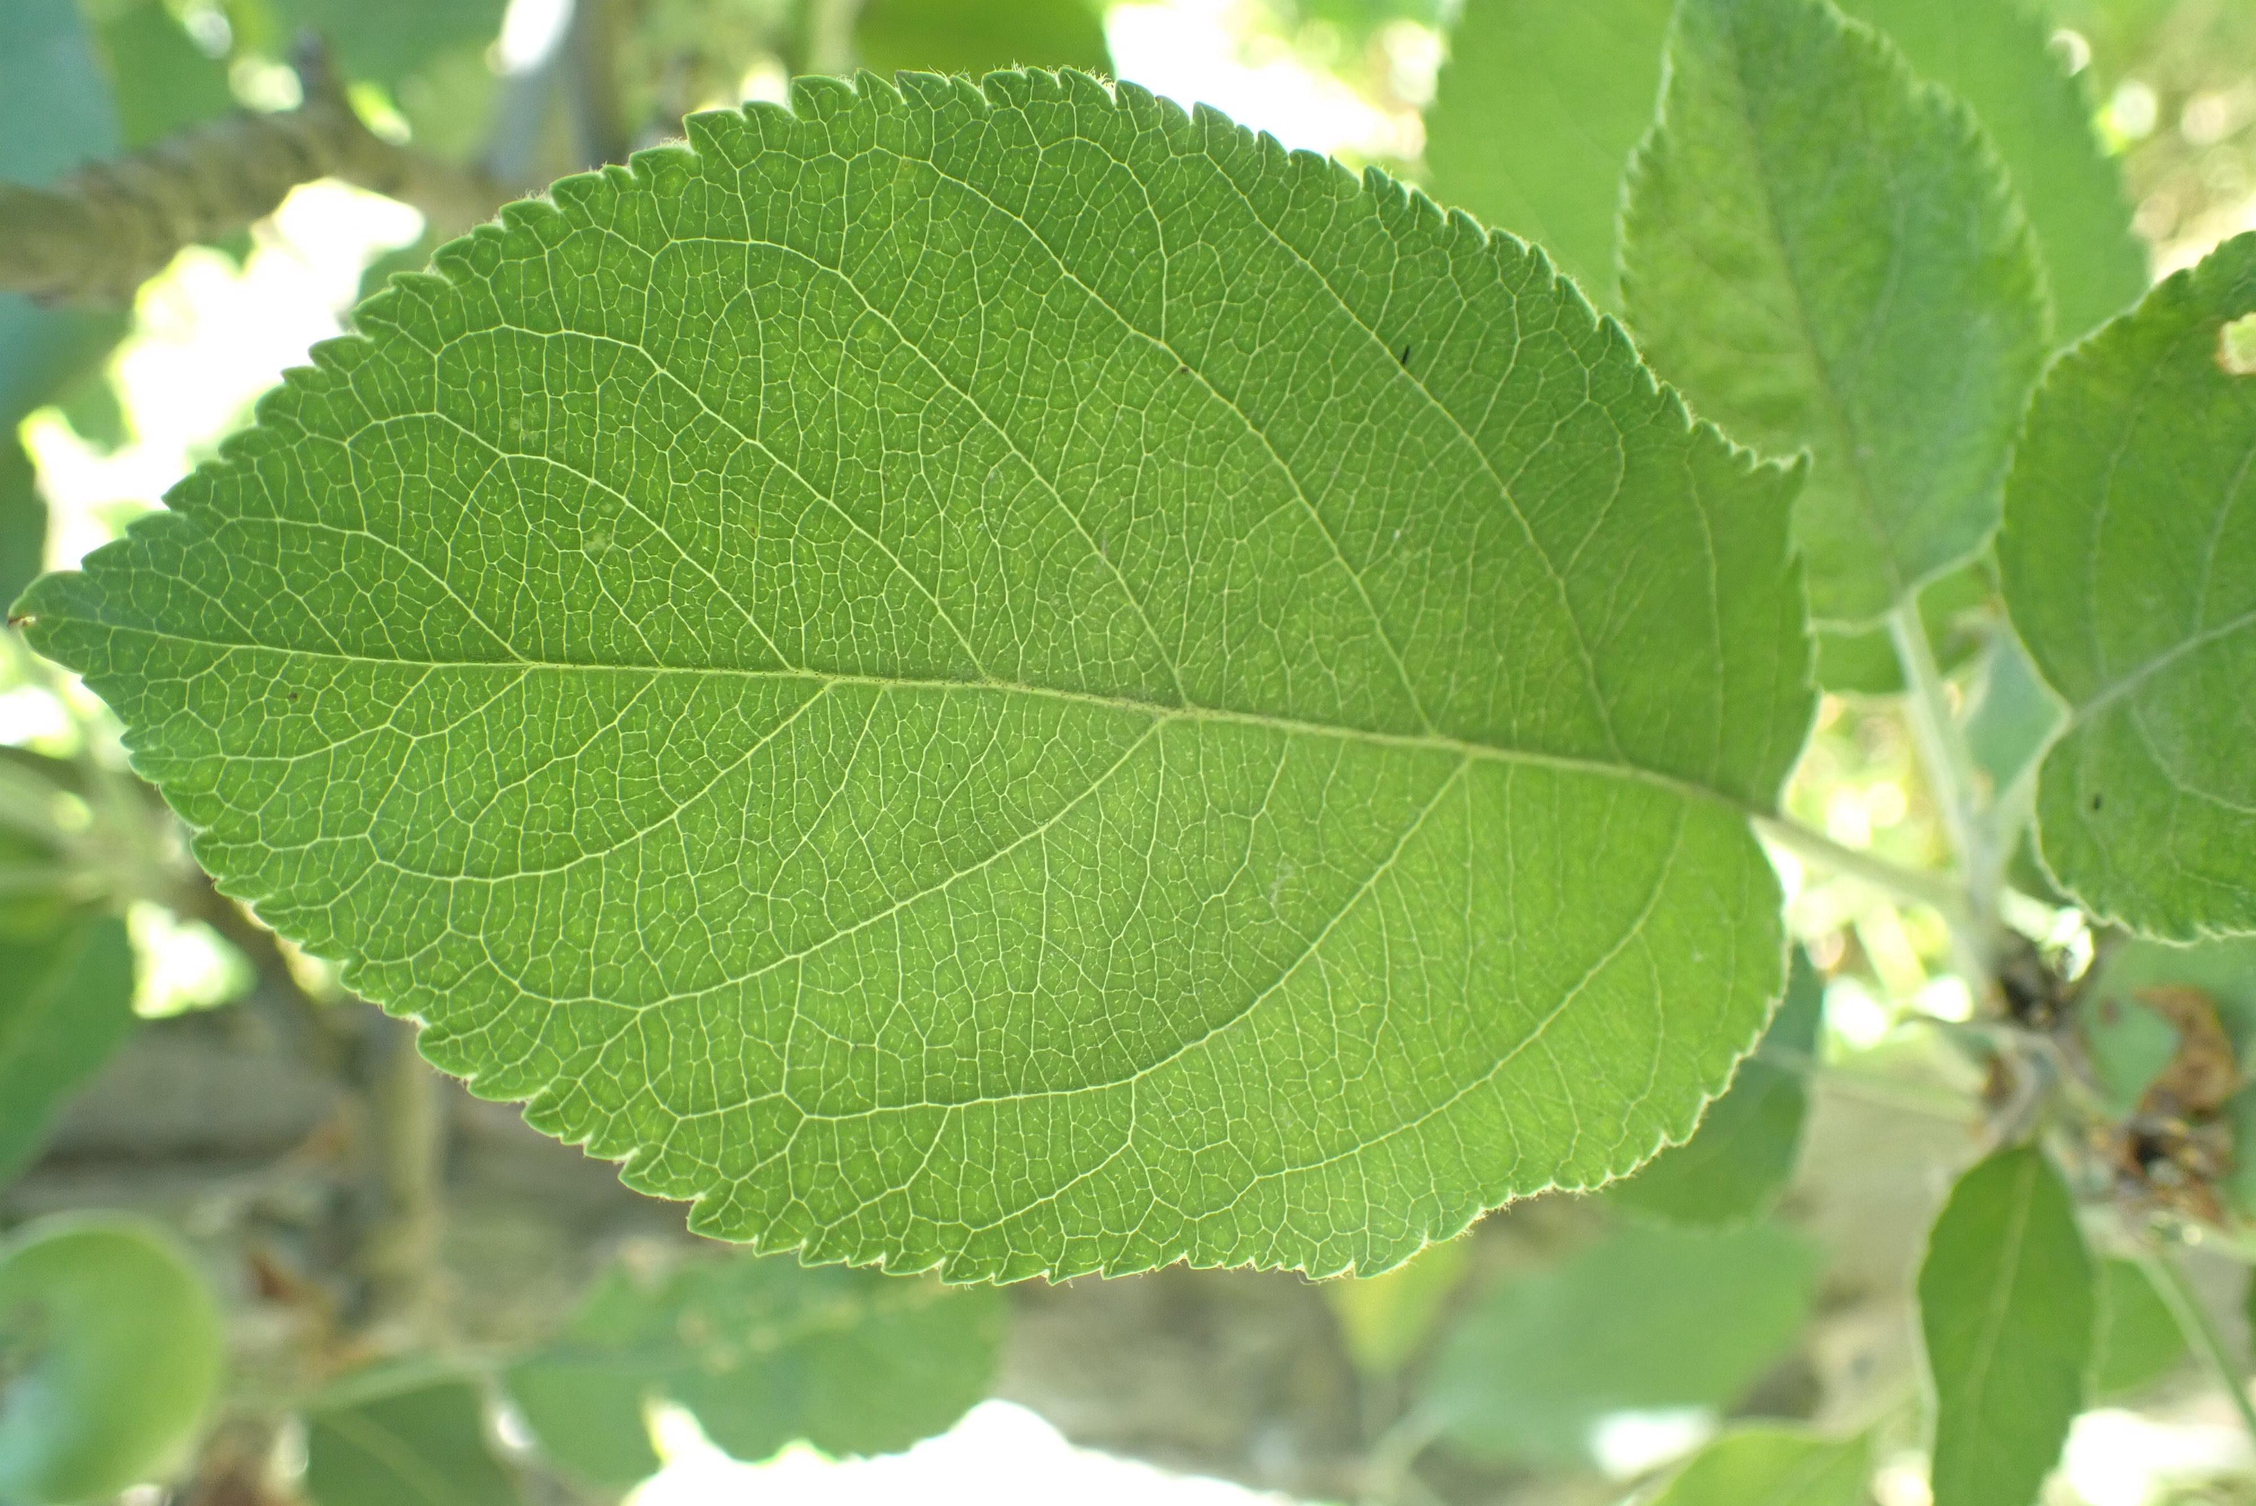
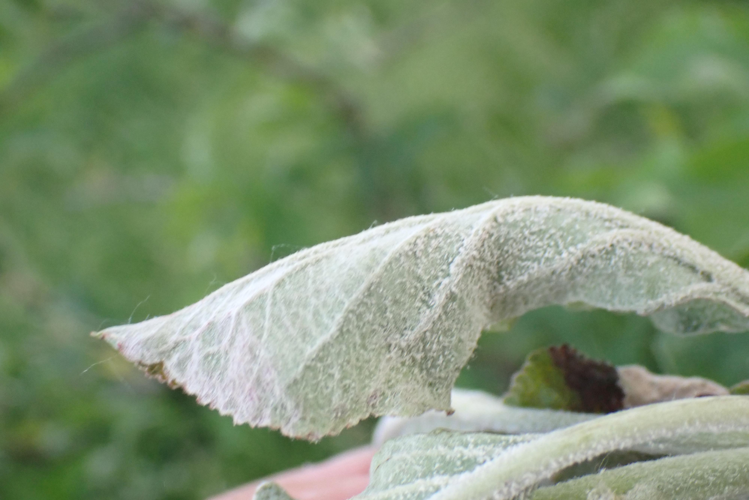
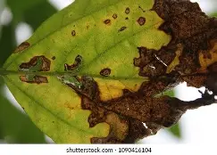
DATASET DESCRIPTION
The dataset used is the Kaggle Plant Disease Dataset. It contains labeled images of plant leaves categorized into:
The dataset is divided into training, validation, and testing sets to ensure proper model evaluation and performance measurement.
Healthy leaves
Powdery Mildew infected leaves
Rust infected leaves

Slide 6
TECHNOLOGIES USED
Frontend: HTML5, CSS3 (Bootstrap), JavaScript (Chart.js for visualization).
Backend: Flask (Python).
AI Framework: TensorFlow & Keras.
Database: SQLite (for tracking prediction history).I
mage Processing: OpenCV, NumPy, Pillow.
Model :CNN

Slide 7
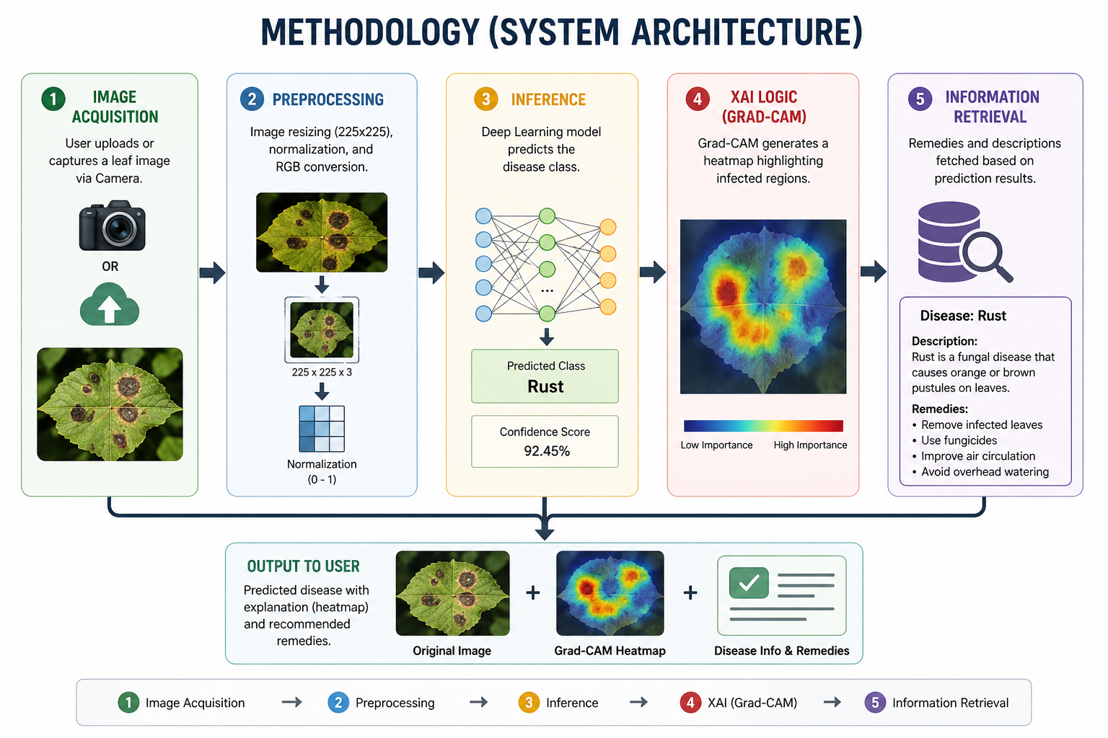
SYSTEM ARCHITECTURE

Slide 8
AI Model ArchitectureType: Convolutional Neural Network (CNN).Structure:
CNN (Convolutional Neural Network) is a Deep Learning model used for image processing
It automatically extracts features like edges, textures, and patterns
It learns from images without manual feature extraction
Used to classify images into different categories
In this project, CNN classifies leaf images into Healthy, Powdery, and Rust

Slide 9
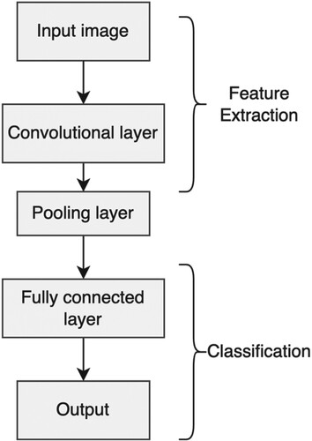
How it works CNN Input Image: A plant leaf image is given to the system Convolution Layer: Detects important features from the image Finds patterns like edges, spots, and textures Pooling Layer: Reduces image size Keeps only important features Makes processing faster Fully Connected Layer: Analyzes extracted features Makes final decision Output: Shows result as Disease or Healthy leaf Also gives confidence score

Slide 10
Explainable AI (Grad-CAM)
Feature: Visualizing the AI's "thought process.“
How it works: It uses gradients from the last convolutional layer to create a heatmap.
Benefit: Increases user trust by highlighting the specific lesions/spots the AI identified as symptoms.
Grad-CAM highlights the infected areas on the leaf
Increases trust and transparency of the model
Helps users understand why a disease is predicted
https://cobalt-oxidation-rockfish.ngrok-free.dev

Slide 11
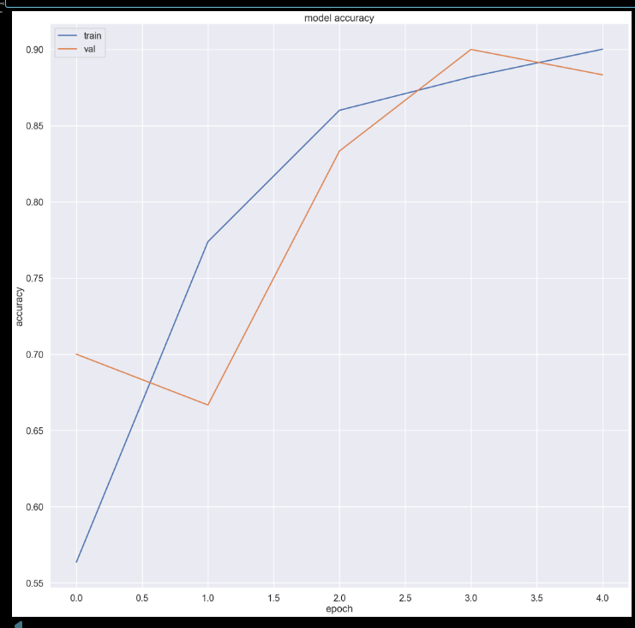
RESULTS
Model Accuracy
The graph shows training and validation accuracy over epochs
🔵 Training accuracy increases from 56% to 90%
🟠 Validation accuracy improves from 70% to around 88–90%

Slide 12
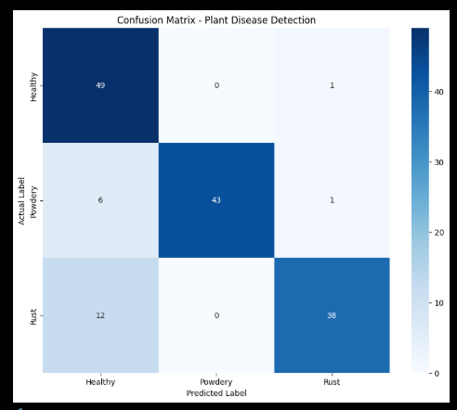
Confusion Matrix
Confusion Matrix shows actual vs predicted results
Diagonal values represent correct predictions
Off-diagonal values represent misclassifications
F1 Score
Measures balance between Precision and Recall
Useful for evaluating model performance on all classes
High F1 Score indicates accurate and reliable predictions

Slide 13
FUTURE ENHANCEMENTS
In future, this project can be improved by:
Real-time live camera detection
Mobile application development
Support for more crop types
Integration of AI chatbot for farmers
Cloud deployment for large-scale usage

Slide 14
Conclusion
This project demonstrates an effective use of deep learning for plant disease detection. The system provides accurate predictions and helps farmers take timely action to protect crops. It serves as a step towards smart agriculture using Artificial Intelligence.

Slide 15
THANK YOU
https://cobalt-oxidation-rockfish.ngrok-free.dev

